Slide 1
Radar Chart Guide
Radar Chart
160
F
100
100
95
90
86
86
86
86
86
86
90
100
110
140
110
100
120
105
130
130
120
120
120
120
120
120
105
130
135
155
130
120
140
150
120
120
100
86
68
40
68
110
50
70
100
145
120
60
125
80
100
Axis Description
60
75
40
50
Axis Description
25
Axis Description
20
J
A
I
P
H
O
G
N
M
E
L
K
D
C
Axis Description
B
Axis Description
Axis Description
Spider Chart
Series 1
Series 2
Created by Edraw - All in One Diagram Software

Slide 2
Contents
Definition of Radar Chart
1
Benefits of Radar Chart
2
Drawbacks of Radar Chart
3
Tips for Developing Radar Chart
4
Radar Chart Software
5
How to Draw a Radar Chart
6
Radar Chart Templates/Examples
7
Created by Edraw - All in One Diagram Software

Slide 3
Definition of Radar Chart
Radar chart is a graphical way to compare data by displaying data in a "web-like" form looking like spider web. So it is also known as spider chart or graph. Usually, it is applied to evaluate multiple alternatives based on multiple criteria.
Created by Edraw - All in One Diagram Software

Slide 4
Benefits of Radar Chart
Makes concentrations of strengths and deficiencies visible.
Clearly displays the important categories.
Clearly defines full performance in each category.
Add interest to what would otherwise be a dry data presentation
Created by Edraw - All in One Diagram Software

Slide 5
Drawbacks of Radar Chart
Radar chart cannot show subtle issues clearly. Radar charts tend to illustrate comparisons through general rating while many evaluation criteria are multifaceted.
Drawback 1
It is cumbersome to compare values on non-adjacent axes, which requires a surprising amount of conscious effort.
Drawback 2
Created by Edraw - All in One Diagram Software

Slide 6
Tips for Developing Radar Chart
No more than 15 alternatives should be compared in radar charts or it will looks cramped.
When rating, you had better use at least three criteria, more may be helpful, but more than seven may be too complex.
It is helpful to standardize ratings to some uniform scale (for example 0-10, or 0-100%).
Using different colors or markers to distinguish each alternative is best.
Created by Edraw - All in One Diagram Software

Slide 7
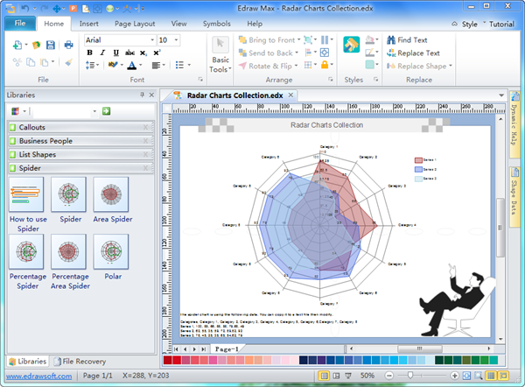
Radar Chart Software
Rich built-in shapes, templates and examples.
Edraw Radar Chart Software - a powerful yet easy to use data analysis tool.
Drag-and-drop interface similar with MS Word.
Automatic function. Import data to make radar chart.
Edraw
Radar Chart Software
100% compatibility with MS programs. 1 click export as other formats.
Created by Edraw - All in One Diagram Software

Slide 8
How to Draw a Radar Chart
1
Identify the series to be compared.
2
Generate criteria to rate each serie.
3
Rate each alternative based on criteria.
4
Select a suitable template and set relevant appearance options. Set and label the axis arms of the chart (one arm for each criterion).
5
Label each alternative's ratings on the chart. When you enter the data, the shape changes automatically.
6
Add some final touches such as background or clipart to beatify it.
Created by Edraw - All in One Diagram Software

Slide 9
Radar Chart Templates/Examples
Title
110
Category 4
Title
100
85
66
88
58
79
68
49
49
49
49
49
62
55
35
59
72
89
82
92
92
92
92
92
78
45
25
35
65
54
62
79
79
79
79
Description
79
91.667
Description
73.333
55
36.667
18.333
Category 7
Category 8
Category 6
Category 8
Category 5
Category 8
Category 8
Category 3
Category 8
Category 2
Category 1
Title
Double click value text to edit the chart data, the point position changes according to the value and axis max value.
Title
Select a series sub shape change its line or fill style.
Series 1
Series 2
Series 3
The spider chart is using the following data. You can copy it to a text file then modify.
Categories, Category 1, Category 2, Category 3, Category 4, Category 5, Category 6,Category 7, Category 8
Series 1, 100, 85, 66, 88, 58, 79,68, 49
Series 2, 62, 55, 35, 59, 72, 89,82, 92
Series 3, 78, 45, 25, 35, 65, 54,62, 79
Created by Edraw - All in One Diagram Software

Slide 10
Public Perception Survey
100
Community Awareness
100
100
90
90
86
86
86
86
65
100
80
85
50
100
100
60
88
100
60
100
70
70
75
100
90
80
70
60
Notes
50
This chart compares the public perception of three high-technology companies. It's based on a hypothetical survey distributed in a popular industry magazine with a circulation of more than 600,000. There were approximately 20,000 respondents. The survey asked participants to rate each subject in eight categories on a scale of 0 to 100.
This analysis shows that for the area of Tech Support, at three companies enjoy similar reputations. This rating might be considered industry standard. The ethical practice category shows a very different picture with the public clearly perceiving company B as behind in that area.
40
30
20
Ethical Practices
Employment Practices
10
Future Orientation
Customer Focus
Tech Support
Product Quality
Brand Reputation
Company A
Company B
Company C
More radar char templates can be found in https://www.edrawsoft.com/spider-chart-solutions.php

Slide 11
Test Scores Analysis
100
80
82
77
68
75
70
90
88
88
83
85
92
68
93
58
63
70
60
80
60
40
20
Chemistry
Geography
Biology
Physics
Math
Computer Science
Average Score of Class 1
Lucy
Tom
See how to use radar chart for data anakysis in

Slide 12
Employee Performance Appraisal
(Scale of 1-5, 5 being the highest)
5
2
5
2
3
4
4
4
4
5
5
4
5
4
3
2
Meeting Deadline
1
Punctuality
Teamwork
Problem Solving
Technical Knowledge
Communication Skills
Calvin
Susan

