Slide 1
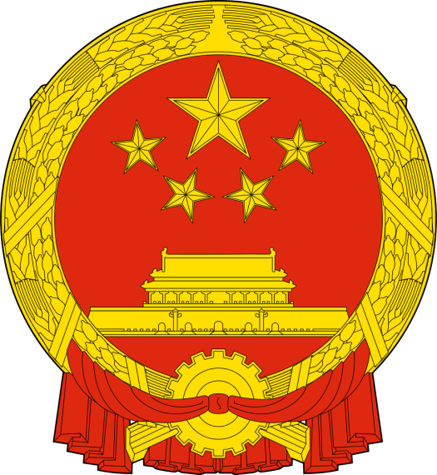
Created by Edraw
People's Republic of China
中华人民共和国
China
National Flag
National Emblem

Slide 2
Created by Edraw
China Country Profile
Timeline
2010
China overtakes Japan as the second largest economy
2005
600 million lifted out of poverty since 1981, according to World Bank.
>10%
Surge in economy on average year from 1978 to 2013
2nd
Largest Economy
1990
Stock markets open in Shanghai & Shenzhen
1.3bn
Population
3rd Largest Country
9,596,961 square kilometers
1989
Tiananmen Square Massacre
GDP Growth Rates
Unit
15
9.6
9.2
10.4
9.2
7.2
9.5
13.5
1984
Opens up 14 cities & 3 regions to foreign investment, including Shanghai
12
10.5
9
7.5
1.5 Tril RMB Yuan
Total FDI volume as of June, 2013
6
4.5
1978
Reformist leader Deng Xiaoping
announces Open Door policy
3
1.5
2008
2009
2010
2011
2012
2013
China

Slide 3
Created by Edraw
Chinese Government
PRC Government
Chinese Communist Party
President
Vice President
General Secretary
Central Military Commission
National People's Congress
State Council
(Work Plan)
Supreme People's Court
Standing Committee
Premier
Supreme People's Procuratorate
Chair
Secretary General
Vice Premier
State Premier
Politburo Standing Committee
Chinese People's Political Consultative Conference
Ministries & Commissions
Other Key Organization
Politburo
Central Committee

Slide 4
Created by Edraw
Chinese History Timeline
Qin - Started Great Wall
Xia Dynasty:
2000BC-1500BC
Shang Dynasty:
1700BC-1072BC
Western Zhou
1066BC-771BC
Eastern Zhou:
770BC-221BC
Qin Dynasty:
221BC-207BC
Western Han:
206BC-AD9
Western Han:
Tang - one of two golden ages of China Xian(Changan) capital, 2 M people, Silk Road, Strongest, Richest in world.
Wei, Shu, Wu
Song, Qi, Liang, Chen
N Wei, E Wei, W Wei, Qi, Zhou
Eastern Han
25AD-220
Three Kingdons
220-280
Western Jin
265-316
Eastern Jin
317-420
Southern Dynasties
420-588
Northern Dynasties
386-588
Sui Dynasty
581-617
Tang Dynasty
618-907
Five Dynasties
907-960
Ten
Kingdoms
907-979
Drag the side handles to change the width of the text block
G. Khna, and Kubilia Khan conquer; Beijing capital; Mongol Empire, linking East and West, promote trade and travel.
Qing - Manchu conquest of Ming, Last Dynasty. Reach peak of power and influence. Orderly, prosperous until 19th century when fell due to inflexibility, rebellions and invasion from the West.
Northern Song
960-1127
Southern Song
1127-1279
Liao Dynasty
916-1225
Western Xia
1038-1227
Jin Dynasty
1115-1234
Yuan Dynasty
1279-1368
Ming Dynasty
1368-1644
QIng Dynasty
1644-1911
Ming- orderly government, social stability, strong, central govt, sea explorations, porcelains widely recognized(blue/white pieces).
Opium War
1839-1842
Kuomindang Party
1912-1949
People's Republic
of China
1949-
Cultuaral Revolution
1966-1976
Tiananmen Square Demonstration
1989

Slide 5
Created by Edraw
Education System of China
Pre-School Education
Kindergarten
Elementary Education
Primary School
General Junior Middle School
Junior Middle School
Comprehensive Junior Middle School
Vocational Junior Middle School
General Education
Secondary Education
General Senior Middle School
Senior Middle School
Vocational Senior Middle School
Technical Senior Middle School
Undergraduate
Universities, Colleges and Institute
Higher Education
Universities
Postgraduate
Research Institutes

Slide 6
Created by Edraw
Administrative Divisions of China
China
ProvinceS
Autonomous Regions
Special Administrative Regions
Municipalities
Prefecture-level Cities
Prefecture-level Units
Hongkong
Macao
Country-level Cities
County
County-level Units
Urban Area
Subdistrict Office
Rural
Town
Neighborhood
Village Committee

Slide 7
Chinese Festivals
恭喜发财，红包拿来
Childrencan get Hong Bao(money given to children as a lunar New Year gift).
1/1: Spring Festival
1/15: Lantern Festival
5/5: Dragon Boat Festival
7/7: Chinese Valentine's Day
8/15:
Mid-Autumn Festival
9/9:
Double
Ninth
Festival
12/30(12/29):
New Year's Eve
Lunar Month
the 1st lunar month
the 2nd lunar month
the 3rd lunar month
the 4th lunar month
the 5th lunar month
the 6th lunar month
the 7th lunar month
the 8th lunar month
the 9th lunar month
the 10th lunar month
the 11th lunar month
the 12th lunar month
January
February
March
April
May
June
July
August
September
October
November
December
Gregorian calendar
1/1
New Year
3/8
Women's Day
4/5
Tomb Sweeping Day
5/1
Labor Day
Youth Day
6/1
Children's Day
7/1
CPC Founding Day
8/1
The Army's Day
9/10
Teachers' Day
10/1
The National Day
12/6
The Nurses's Day

Slide 8
Created by Edraw
Chinese Zodiacs
2008
2009
2010
2011
2012
2013
Ox
鼠 Mouse
兔 Rabbit
蛇 Snake
虎 Tiger
龙 Dragon
Monkey
Rooster
猪 Pig
马 Horse
狗 Dog
羊 Sheep/Goat
2014
羊 2015
2016
2017
2018
2019

Slide 9
Created by Edraw
Top 10 Tourist Attractions of China
China
1
Great Wall - Beijing
2
West Lake - Hangzhou
不到长城非好汉。
He who has never been to the Great Wall is not a true man.
Gulangyu - Fujian Province
Great Wall
3
4
Sanya - Hainan Province
Mount Huangshan
5
Guilin -Guangxi Zhuang Atunomous Region
Potala Palace
JIuzhai Valley
West Lake
Zhangjiajie -Hunnan Province
Lijiang ancient city
Zhangjiajie
6
Gulangyu
West Lake 西湖
欲把西湖比西子，
浓妆淡抹总相宜。
7
Lijiang ancient city -Yunnan Province
8
JIuzhai Valley - Sichuan Province
Guilin
9
Mount Huangshan -Anhui Province
Sanya
10
Potala Palace - Tibet
Lijiang River 漓江
桂林山水甲天下。
East or west, Guilin is the best .

