Slide 1
P&ID Guide
Definition of P&ID
1
Benefits of P&ID
2
Main Contents of a P&ID
3
P&ID Software
4
5
Tips to Draw P&ID
6
P&ID Examples
Created by Edraw - All-in-one Diagram Tool

Slide 2
Definition of P&ID
P&ID, short for piping and instrumentation diagram, is a process documentation representing technical realization of a process by means of graphical symbols, such as the service lines, instruments and controls, valves, and equipment. It is often used to by engineers and technicians to better understand the process and how the instrumentations are connected.
Created by Edraw - All-in-one Diagram Tool

Slide 3
Benefits of P&ID
Increase productivity and data quality, thus reducing project hours and costs
Facilitate compliance with regulatory and safety requirements
Streamline daily work processes
Decrease time to market, achieving higher productivity and profitability
Allow the management of global, multi-site projects
Integrate with partner enterprises and associated tasks
Reduce investment and increase Return On Assets (ROA)

Slide 4
Main Contents of a P&ID
Instrumentation and designations;
Mechanical equipment with names and numbers;
All valves and their identifications;
Process piping, sizes and identification;
Miscellaneous - vents, drains, special fittings, sampling lines, reducers, increasers and swagers;
Permanent start-up and flush lines;
Flow directions;
Interconnections references;
Control inputs and outputs, interlocks;
Seismic category;
Interfaces for class changes;
Quality level;
Annunciation inputs;
Computer control system input;
Vendor and contractor interfaces;
Identification of components and subsystems delivered by others;
Intended physical sequence of the equipment;
Equipment rating or capacity.
Created by Edraw - All-in-one Diagram Tool

Slide 5
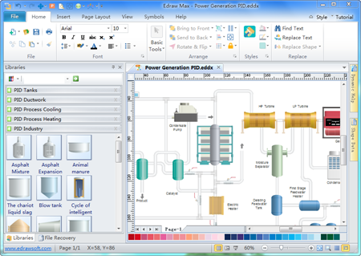
Edraw P&ID Software
Thousands of predefined PID symbols, photorealistic, vector and easy-to-use.
Support shape data, equipment report, hyperlink, multiple page document, large size print.
A wide variety of readymade templates and examples.
100% compatible with MS programs.
Microsoft-like interface, intuitive and user-friendly.
Edraw P&ID Software - Create Visual P&IDs
Instantly with Predefined Shapes
Created by Edraw - All-in-one Diagram Tool

Slide 6
Tips to Create P&ID
Be consistent in using the symbols. Always keep a copy of the project’s current Symbol and Legend sheet near for easy referral.
01
Take advantage of software to do it instead of drawing by hand, saving both time and effort.
04
02
Text should not be smaller than 1/8" unless absolutely necessary. Text must be of adequate size to produce legible reproductions on reduced size prints of drawings.
03
Ensure accuracy. Less mistakes will actually lead to increased speed in the long run because repeated rework can be avoided.
Created by Edraw - All-in-one Diagram Tool

Slide 7
Central Air Conditioning System Structure Diagram
Feedwater
Circulation Water Tank
Cooling Tower
Main
Engine
Evaporator
Condenser
Fan Coil Unit
Freezing Pump
Temperature Measurement Resistor
Temperature Measurement Resistor
Temperature Measurement Resistor
Cooling Pump
Smart Temperature Controller
Smart Temperature Controller
Created by Edraw - All-in-one Diagram Tool

Slide 8
13
Air bottle
10
Compressor
14
15
16
2
17
Set box
11
6
1
3
7
4
8
2
12
5
9
2
2
Created by Edraw - All-in-one Diagram Tool

Slide 9
Complete Set of Production Equipment
and Process of Juice and Nectar
Fruit Washing Machine
Fruit Picking Machine
Crush
Jacketed Pan
Deoxygenation
Beater
Blend
Centrifugalization
High-position Storage Tank
Filter
Stabilization Tank
Ultra High Temperature Sterilizer
Homogeneity
Can Washing Machine
Filling Machine
Can Seamer
Steam Sterilizer
Created by Edraw - All-in-one Diagram Tool

