Slide 1



Name
Name
Organizational Chart
Name
Title
Title
1
Title
Name
Name
Definition of Organizational Chart
Title
Title
Name
Name
Title
Name
Title
Name
Title
Name
2
Title
Types of Organizational Chart
Name
Name
Name
Name
Name
Title
Title
Name
Name
Name
3
Benenefits of Organizational Chart
Shareholder
Board
Inspection
4
Limitations of Organizational Chart
Director
Title
Title
Title
Title
Title
5
Organizational Chart Software
Title
Title
Title
Title
Title
Title
Title
Title
Title
Title
Title
Title
6
Organizational Chart Examples

Slide 2
Definition of Organizational Chart
An organizational chart (often called organization chart, org chart, organigram(me), or organogram(me)) is a diagram that shows the structure of an organization and the relationships and relative ranks of its parts and positions/jobs. The term is also used for similar diagrams, for example ones showing the different elements of a field of knowledge or a group of languages.
Created by Edraw - All-in-one diagramming Software.

Slide 3
Types of Organizational Chart
1. Hierarchical
A hierarchical organization is an organizational structure where every entity in the organization, except one, is subordinate to a single other entity.
2
1
2. Matrix
It is a type of organizational structure in which people with similar skills are pooled for work assignments, resulting in more than one manager (sometimes referred to as solid line and dotted line reports, in reference to traditional business organization charts).
3
3. Flat
Also known as horizontal. An organization that has an organizational structure with few or no levels of middle management between staff and executives.
Created by Edraw - All-in-one diagramming Software.

Slide 4
Benenefits of Organizational Chart
Reasonable Structure
Managemant Tool
Helps build and design the organization structure. Help divide the functions of a company, enterprise or department to meet the business' objectives.
Use the organizational chart tool to analysis budget, design work team and generate reports.
4
5
6
1
2
3
Better Performance
Org Chart
Rights Guide
Help understand and enhance the coordination of the organization. Let everyone clear within their organizations and improve employee performance.
Guide the employees to know their rights and responsibilities.
Task Assignment
Relatinship Guide
Find out whether the officer's workload is too heavy. Find out whether the unrelated persons undertake the work of several loose, no relationship.
Shows the relationships between the organization's staff members
Created by Edraw - All-in-one diagramming Software.

Slide 5
Limitations of an Organizational Chart
It only shows "formal relationships" and tells nothing of the pattern of human (social) relationships which develop.
It shows nothing about the managerial style adopted (e.g. autocratic or democratic)
It very quickly becomes out-of-date, especially in large organizations who change their staff regularly.
Created by Edraw - All-in-one diagramming Software.

Slide 6
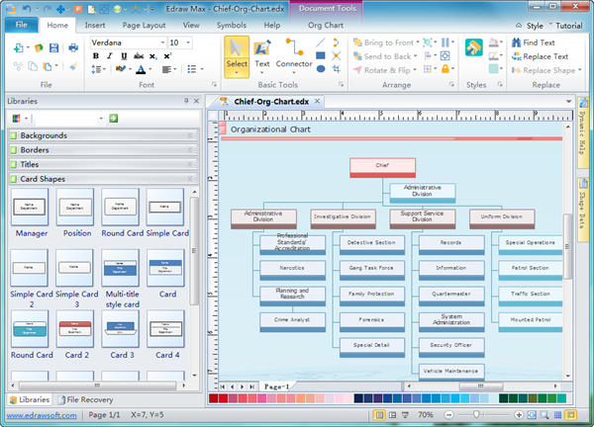
Organizational Chart Software
Org Chart Software Features
The user-friendly interface is similar with MS Office. Easy to use.
Supports full compatability with MS Office. 1 Click exports org chart as Word, Excel, PowerPoint and PDF and many other formats.
Shapes and connectors can be generated automatically.
Shapes generated automatically are the same size by default.
Relayout requires only 1 click.
Specialized org chart tools enable easier and faster formatting and modification.
Photo shapes containing action button allow quick insertion of photos.
Photos are resized after inserted to fit shapes automatically.
Edraw - An easy and effective organizational chart creator to help you
organize for efficiency, visualize for consensus and strategize for success.
Created by Edraw - All-in-one diagramming Software.

Slide 7
Top Tips to Make Org Charts Work
Use both vertical and horizontal layouts for optimal scanning.
Make shapes of the same level the same size.
Space all shapes evenly.
Update org chart in time.
Use org chart software to automate some steps. Draw org chart automatically by importing data
Created by Edraw – An advanced org chart tool.

Slide 8

Org Chart example - Marketing Department
Marketing Director
Default Name
Marketing Communications Mgr.
Business Development Manager
Default Name
Name
Marketing Communications Mgr.
Marketing Communications Mgr.
Responsibility 1
Responsibility 2
Default Name
Default Name
Default Name
Default Name
Employee
Employee
Employee
Employee
Default Name
Default Name
Default Name
Default Name
Employee
Employee
Employee
Employee
Default Name
Default Name
Default Name
Default Name
Employee
Employee
Default Name
Default Name
Employee
Default Name
Created by Edraw - All-in-one diagramming Software.
http://www.edrawsoft.com

Slide 9
Purchasing Services Reporting Structure
Michael Demker
CEO
Linda Stares
Executive Assistant
Hein Sabelis
Steven Golding
Linda Mortland
Julie Krause
Annett Boger
Sales President
Marketing President
Chief Financial Officer
CTO
Human Resources Director
Rune Johannessen
Tammy Hendrickson
Atheeq Ahmed
Vincent Blignaut
Lawrence Flint
Jan Nielsen
Sales Manager
Market Strategy
Account Manager
Senior Engineer
Project Manager
Human Resources Manager
Tony Coo
David Wilburn
Sandra Sifford
David Gottelier
Carole Riley
Edward Miller
Sales Director
Marketing Director
Cash Manager
System Engineer
System Analyst
Recruiting Manager
Fabio Desideri
James Doeble
James Mosely
Daniel Gombe
James Dammar
Marty McGhie
Sales Manager
Partner Relations
Planning Manager
Engineer
Web Designer
Compensation & Benefits Specialist
Janet Wilson
Ruth Barnsley
Keisha Fields
Lene Mathisen
Thomas Coady
Robert Barnett
Sales Associate Manager
Online Sales Director
Settlement Officer
Communications Engineer
Software QA Engineer
Office Support
Michael Andrews
Nick Faarvang
Sacha Roest
Campaign Manager
Information Security Engineer
Test Engineer
Created by Edraw - All-in-one diagramming Software.

Slide 10
Org Chart Example - Project Team Development
CTO/VP Engineering
Project Manager
Project Specialist
System Analyst
System Administrator
Technical
Training
Core
Team
Requirement Analyst
Senior Hardware Engineer
Senior Software Engineer
Technical Support
Technical Clerk
Hardware Engineer
Software Engineer
QA Manager
Database Engineer
Support Team
Web Designer
Software QA Engineer
Documentation
Information Security Engineer
Created by Edraw - All-in-one diagramming Software.

Slide 11
Custom Organizational Chart
Staff Name
Staff Name
Staff Name
Superior
Staff Name
Staff Name
Staff Name
Company Structure
Development
Marketing
Staff Name
Staff Name
Staff Name
Staff Name
Created by Edraw - All-in-one diagramming Software.
Company name/Author

