Slide 1

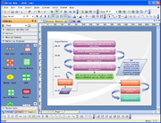
Edraw Order Flowchart
Get the payment
Invoice
Pay
RegNow Order
Department
Live Support From Edraw
support@edrawsoft.com
Phone Order/Fax Order
Confirm Order
Submit
Send the license information
Visit http://www.edrawsoft.com to put the order
Choose the
payment type
Put the Order Online
Users
Order Process System
Users
Confirm Order
Activate
Get the payment
Get the Activation Code
to Activate Edraw Manually
RegNow Order
Department
Failed
Go to Edraw Assist Page
Support Phone Order
Call Customer Service Center at +1-952-646-5331 or toll free from the US and Canada at 1-877-353-7297 to place an order by phone. The product id is 12786-9

