Slide 1
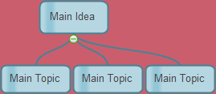
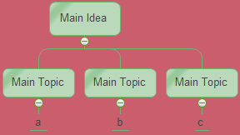
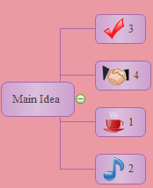
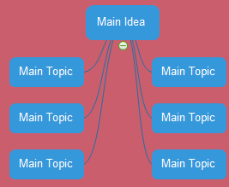
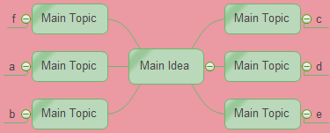
Click here to Get Rich Diagramming Resources from Edraw
Mind Map
Main Topic
Main Topic
Main Topic
Main Idea
Main Topic
Main Topic
Main Topic
Main Topic

Slide 2
Main Contents
1
2
3
4
Definition of Mind Map
Benefits and Application of Mind Map
Rules and Tips to Draw Mind Map
Examples of Mind map

Slide 3
1. What Is Mind Map
Mind map is a diagrammatic method of representing ideas, with related concepts arranged around a core concept

Slide 4
2.1 Benfits of Mind Map
Visualize, organize, and classify ideas.
Boost brainstorming and idea generation.
Boost creative thinking.
Organize life through visual work and activity schedule.
Promote effective communication.
Enhance studies.
Accelerate problem solving and decision making.

Slide 5
2.2. Application of Mind Map
Deliver lecture.
Design presentation.
Note-taking.
Brainstorming.
Make plans and set goals.

Slide 6
3.1. Rules to Draw Mind Map
Hyperlinks
Multiple colors
Start
Center
Use
Image of the topic
Images/symbols
Codes
In order
Dimensions
Clarity
Hierarchy
Outlines
Print
Upper
Keywords
Mind Map
Guidelines
Unique
Case letters
Style
Lower
Personalized
At least 3
Colors
Use association
Connection
Same length as word/image
Refine relationship
Lines
Connected
Emphasis

Slide 7
3.2. Tips for Better Mind Map
Insert clipart or custom shapes to make ot personalized.
Make sure all of your objects are properly aligned and distributed
Choose suitable layout style.
Insert hyperlinks to link websites or other resources to make it rich and inclusive.
Save mind maps as JPEGs to ensure clear presentation.
Combine mind map with other diagrams to be more convincing.

Slide 8
4.1 Mind Map Examples - Education
Mind Map Usage for Teaching
1
Curriculum Planning
Pre-class
Usage
7
Student Assessment
2
Lesson Preparation
Mind Map
Usage
for
Teaching
After
Class
Usage
8
Self-Evaluation
3
Delivering Lessons
4
Making Handouts
9
Promoting Collaboration
In-Class
Usage
Designing Extra
Curriculum Activities
Encouraging Discussion and
Independent Thinking
10
5
6
Boosting Creativity

Slide 9
4.2 Mind Map Examples - Health
Healthy Ways to Decrease Stress
Savor a warm cup of coffee or tea
Spend time in nature/Travel
Read encouraging books
Talk with friends
Work in your garden
Go for a walk
Play with a pet
Work out
Go shopping
Take a long bath
Listen to music
Write in your journal
Watch a comedy
Light scented candles
Have a massage or lavipeditum
Eat more fruits and vegetables
Talk with friends
Drink warm coffee
Eat more fruits
Read
Write journal
Exercise
Listen to music

Slide 10
4.3 Mind Map Examples - Business
Study and prepare for internet marketing
A Superior Product
Marketing Plan
Learn about successful models
Creative planning
Internet marketing team building
Words That SELL
Marketing Team
Internet marketing team management
Website positioning
A Newsletter
Marketing Website
Website design
Website management
Design customer feedback channel
Public Relations
Internet Marketing
Key words setting
Optimization and Promotion
SEO and SEM
Search Engine Optimization
B2B, B2C, C2C analysis
Service System
Build standard after sales system
Build an efficient customer service department
Word-of-mouth marketing
Brand Shaping
Brand Marketing
Differentiation strategy
Successful case analysis

Slide 11
4.4 Mind Map Examples - Self Improvement
Need to meet
more often
Good French
Languages
Fluent English
Drawing
Skills
Computers
Argue often
Office Programming
Friends
Writer
Have many
Abroad
Lazy
Educated
Get bored soon
Strong Sides
Smart
Weak Sides
Main Idea
Enthusiasm
I'm working
on it!
Absent-minded
Too talkative
Meeting people
Wow
William Shakespeare
Games
Like
Mark Twain
Star War
Football
Hobbies
Charles Dickens
Sport
Read books
Cycling
Oscar Wilde
Traveling
Robert Frost
Hiking
Edgar Allan Poe
Self Analysis

