Slide 1

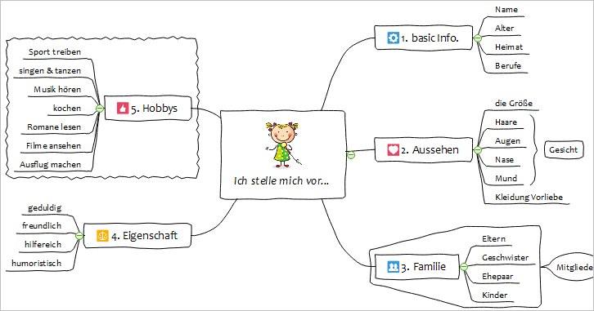
MindMaster
Cross-platform Mind Mapping Software for Windows, Mac and Linux
www.edrawsoft.com/mindmaster/
SHENZHEN EDRAW SOFTWARE CO.,LTD.

Slide 2
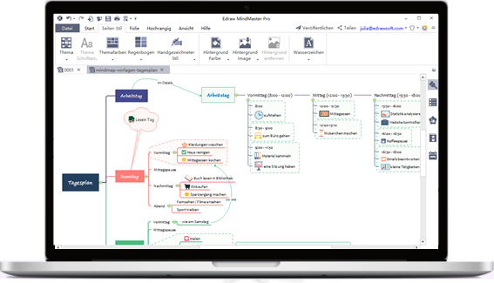
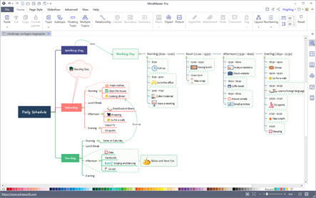
01
Easy Mind Mapping
MindMaster Functions / Features
02
Powerful Presentation
03
Brainstorming
04
Gantt Chart Mode for Project Management
05
Export to Graphics, PDF, Office, Html, SVG...
06
Team Cloud Collaboration
07
MindMaster Community

Slide 3
01. Amazingly Easy Mind Mapping Experience
Quick Mapping
2
Various Ways to Enrich Your Map
1
You can either click on the floating buttons and context menus, or using quick keyboard shortcuts to create mind maps. The speed can be as fast as word typing.
It supports to add hyperlinks, attachments, notes, commentss, tags, marks, cliparts, and pictures and so on to the mind map, so that the ideas and content can be better represented.
Multiple Layouts to Apply
4
30 Themes to Choose
3
The layout is not limited to the traditional radiation style. You can change to many different layouts freely, such as the tree, fishbone, timeline, bubble style, etc.
With 30+ themes for you to choose from, you can easily get an ideal style to fit your requirements. You can also ustomize the colors, shapes, background, connector lines, layout according to the needs.

Slide 4
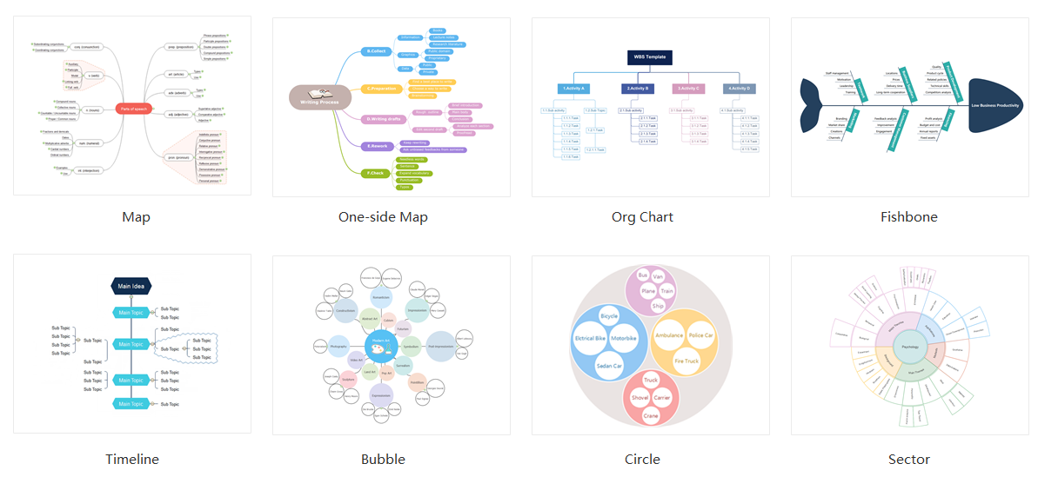
Various Layouts

Slide 5
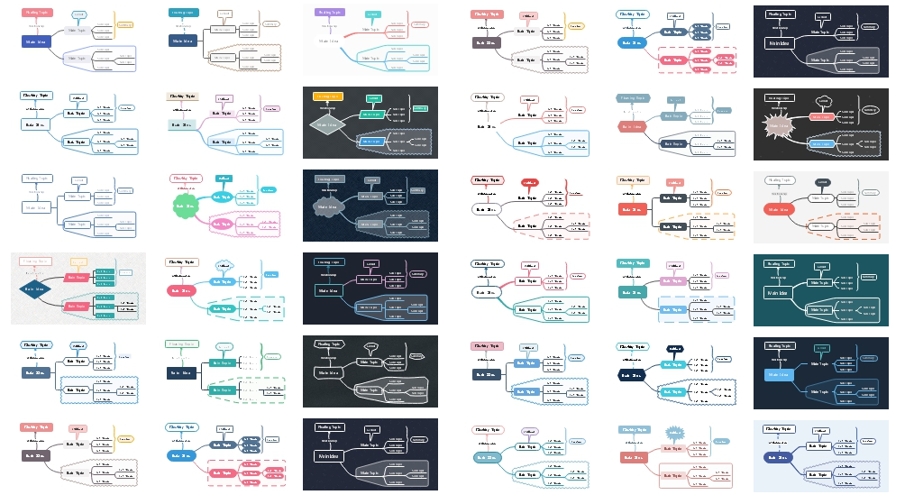
Various Themes

Slide 6
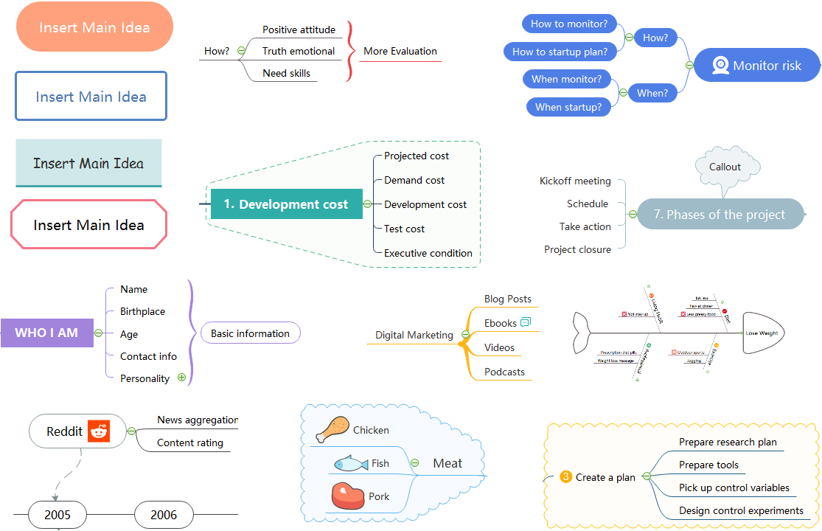
Various Styles

Slide 7
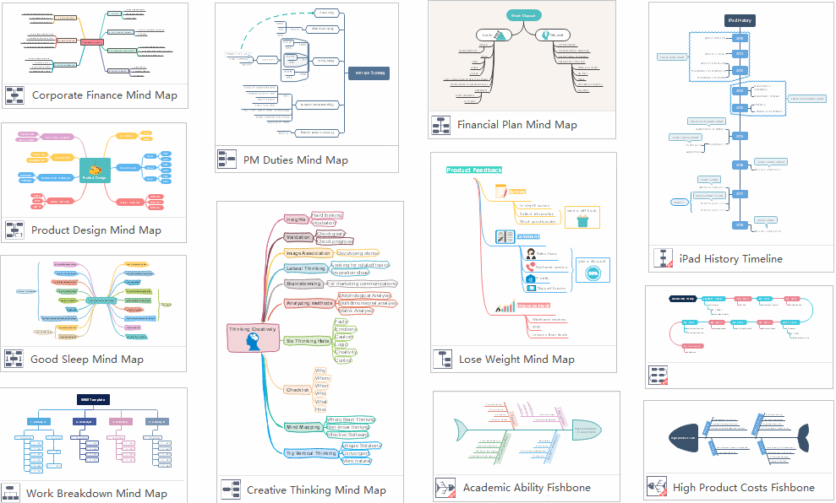
Various Mind Map Templates

Slide 8
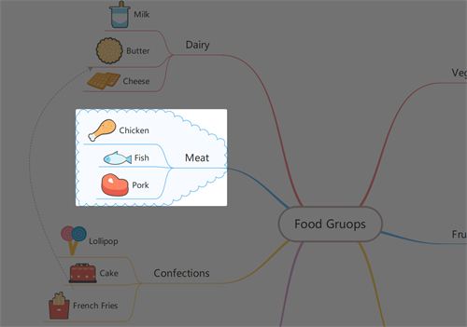
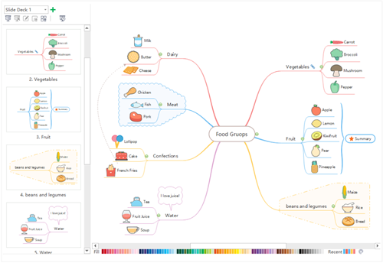
Two Ways of Presentation
1. Traverse Mode
2. Auto create slideshow
MindMaster allows you to present your map with a moving spotlight on topics in the full screen mode.
MindMaster lets you generate slides automatically according to the branches in the mind map.

Slide 9
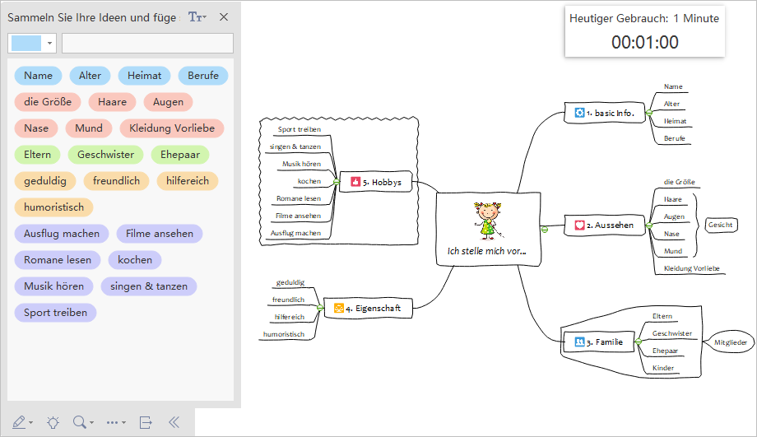
Brainstorming
The brainstrorming mode is used for the two stages of brainstorming session: the proposing and generating, the filtering and combination.
The left side is the ideas colletion board for taking notes of participants' opinions and the right side is used for making a mind map to filtering and reviewing ideas.
The timer records the meeting time.

Slide 10
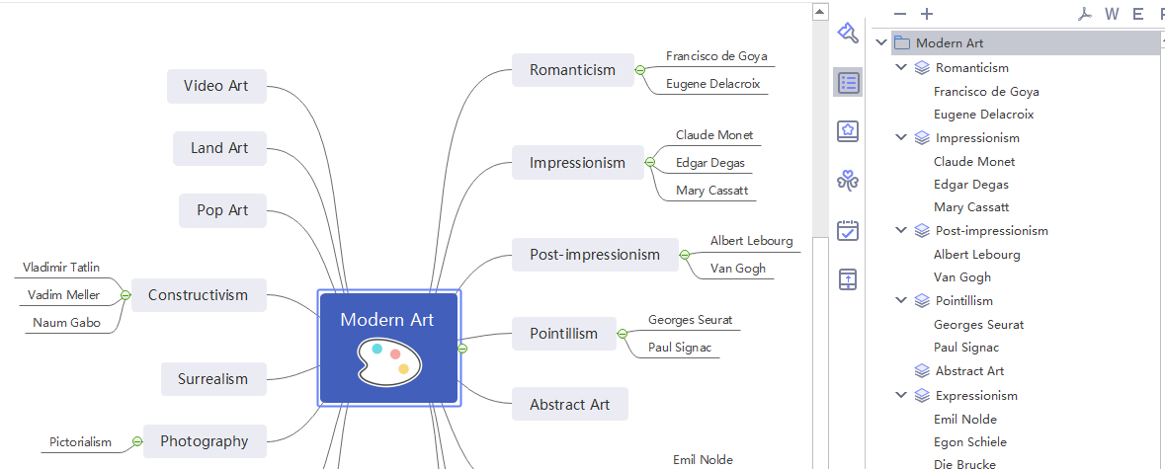
Outline View
The following picture shows a daily planning mind map. Based on this mind map, you can gradually cultivate good habits in life to promote physical and mental health, and ease your pressure etc.
From here users can check out their current mind map in the Outline View mode, then export to word, pdf or excel.

Slide 11
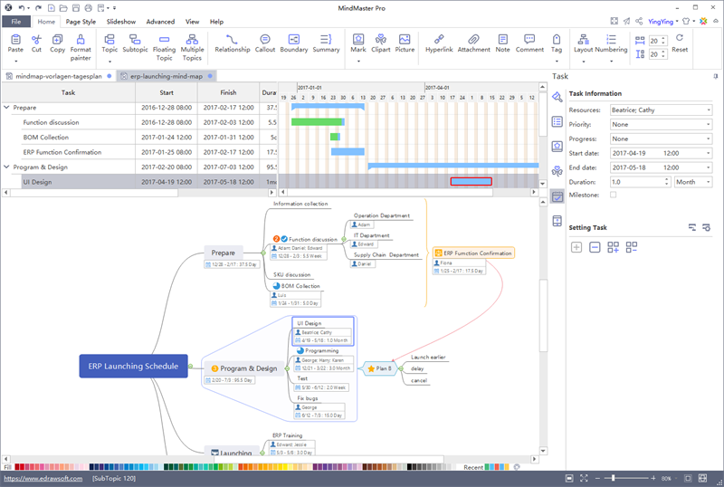
Use Gantt Chart for Project Management
In MindMaster, users can not only use mind maps for project planning, but also record and assign tasks in the taskbar, and finally use Gantt charts for project management.
In the taskbar, you can enter resources, priorities, start and end dates, and task processes.
Next, you can create a Gantt chart within one click to edit and modify the task information in your Gantt chart.

Slide 12
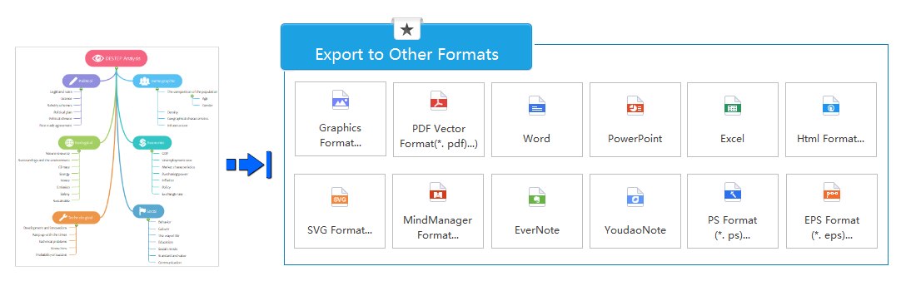
Export to Various Format
You can share your mind maps on SNS platforms, or export to Graphic formats (BMP, JPEG, PNG, and GIF etc.), PDF, PS, EPS, Office (Word, PowerPoint, Excel), Html, SVG, MindManager.

Slide 13
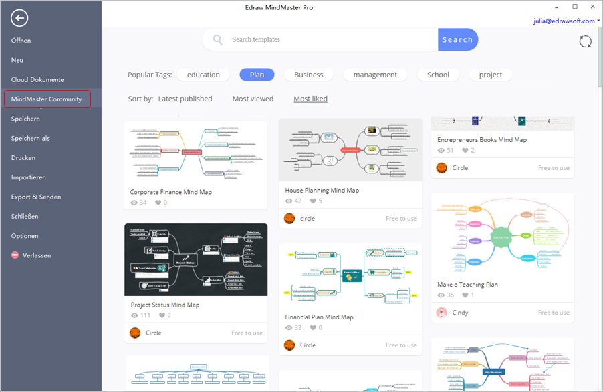
MindMaster Community
The main purpose of the community is "Sharing and Acquiring", which means to share the mind maps based on your knowledge and ideas, and to obtain the mind maps that solve your urgent problems. Users are free to upload any excellent templates at any time, with a wide range of fields and topics in different industries.

Slide 14
Thanks for Your Time！
www.edrawsoft.com/mindmaster/

