Slide 1
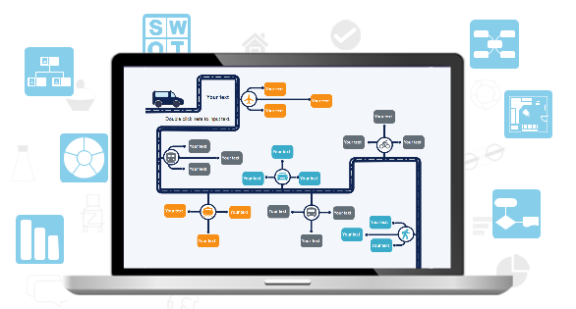

Edraw Max
All-in-One Diagramm Software
Professional diagram software for Windows, Mac and Linux.
Provides all visualization solutions from diagram drawing, graphic design to data visualization.
Official Webseite：https://www.edrawsoft.com/edraw-max.php

Slide 2
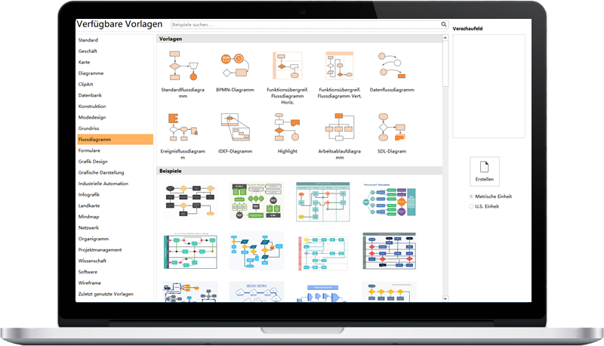
Edraw Max
Stimulate your creativity. Create perfect diagrams.
01
All-in-One Diagramm Software
02
Abundant Templates & Examples
03
Extensive Vector Symbols
04
Smart & Intuitive Drawing
05
Used as a Visio Alternative

Slide 3
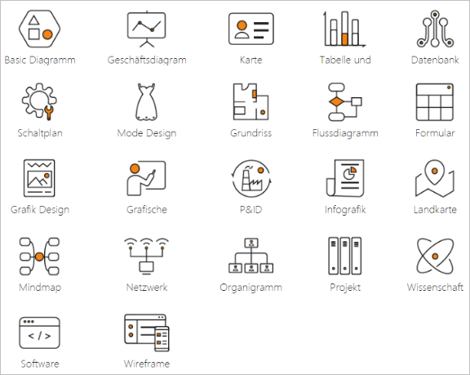
Edraw Max - All in One Diagramm Software
  Edraw max is an all-in-one diagramming tool which can handle more than 260 types of diagrams, including flowcharts, org charts, electrical diagrams, infographics, etc.
  Flowchart
  Network Diagram
  Organizational Chart
  Business Diagram
  Science and Education
  Mind Map
  Fashion Design
  UML Diagram
  Workflow Diagram
  Software Development
  Infographics
  Electrical Diagram
  P&ID
  Clipart
  Floor Plan
  Charts and Graphs
  Gantt Chart
  Map
  Web Diagram
  Graphic Organizers
  Card
  And more…

Slide 4
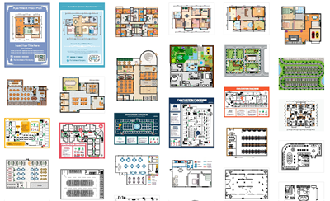
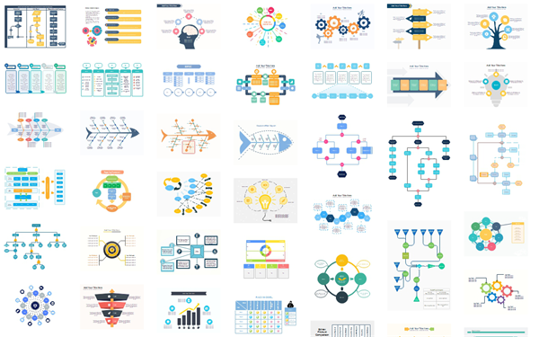
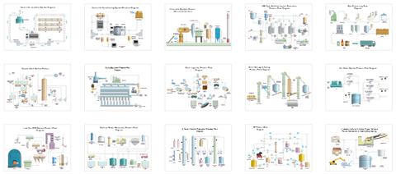
Thousands of Templates Free to Use
  There are templates for each drawing type that help users start quickly and save time. You can find 3000+ templates in total in Edraw Max.

Slide 5
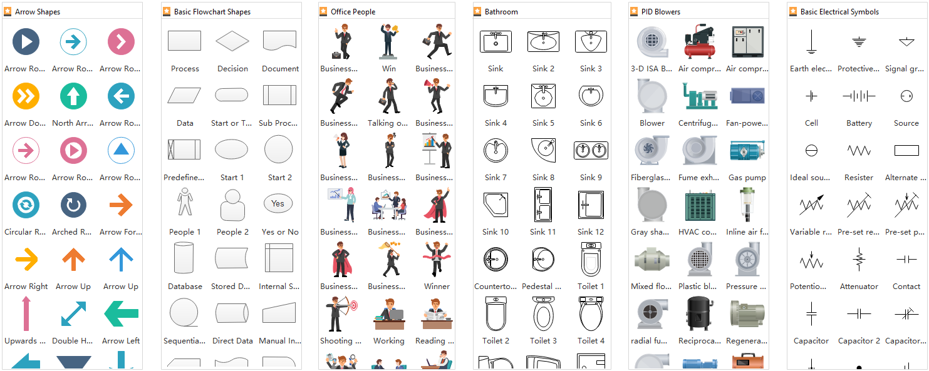
Rich Symbols and Elements
  The software offers more than 12000 vector symbols. Simply drag and drop the symbols to create your designs.

Slide 6
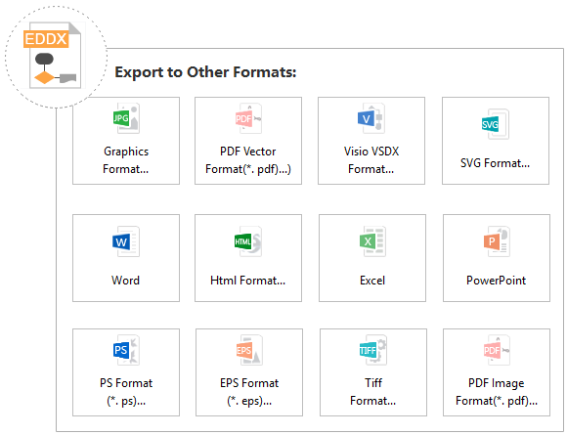
Export to Other File Formats with 1 Click
  Through one click you can turn your drawing to other file formats such as PDF, JPG, Word, Excel, PPT, Html, Visio, etc.
  JPG, PNG
  PDF
  VSDX
  DOCX (Word)
  PPTX (PowerPoint)
  XLSX (Excel)
  SVG
  HTML
  SVG
  PS, EPS
  TIFF

Slide 7

Present Data Attractively in Diagrams and Charts
  Make data clear at a glance.
  Combine data with diagrams.
  Make your diagrams and charts more dynamic by inserting hyperlinks, notes and attachments.

Slide 8
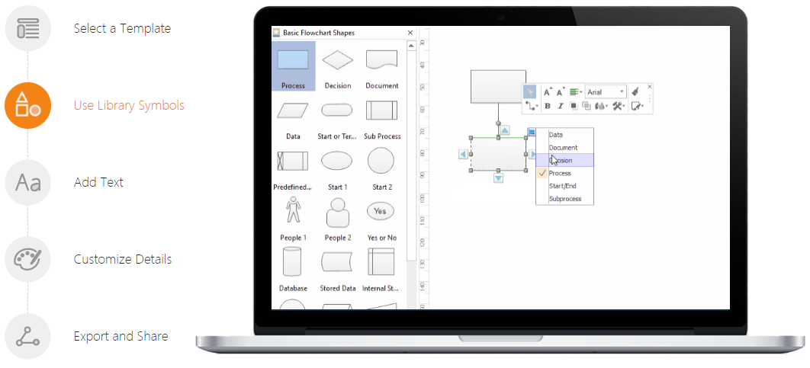
No Drawing Skill is Required
  You can create a diagram in only 5 steps, no drawing skill is needed.
1.
2.
3.
4.
5.
Tutorials: https://www.edrawsoft.com/howitworks.php

Slide 9
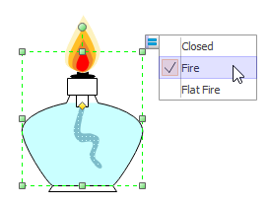
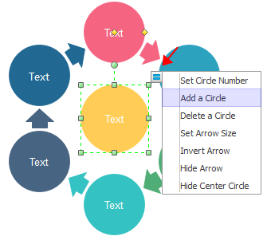
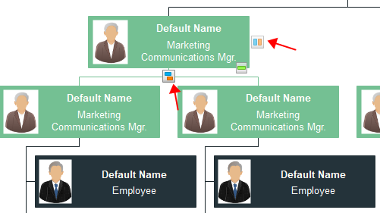
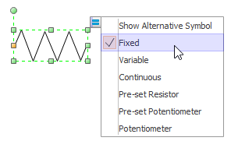
Use Quick Floating Buttons
  The quick floating buttons allow you to reach the result your want in a smarter way.
  For example:
  By clicking the floating button, you can quickly change another symbol style.

Slide 10
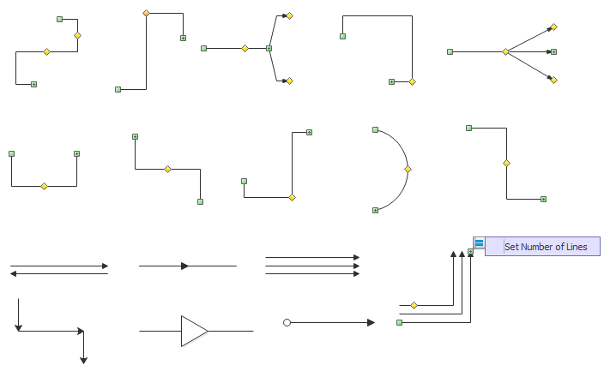
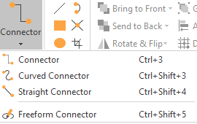
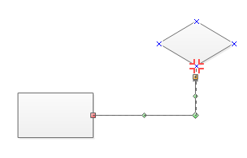
Use Smart Connector to Connect Shapes
  The connectors can be glued to shapes so that when you move the shapes it will remain connected.

Slide 11
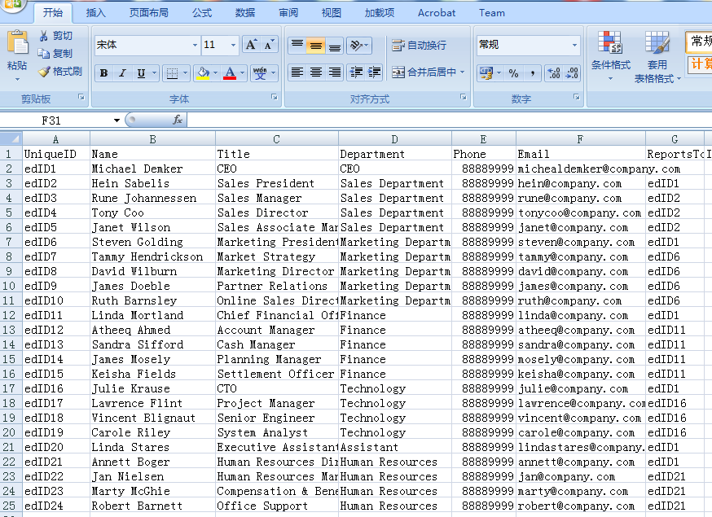
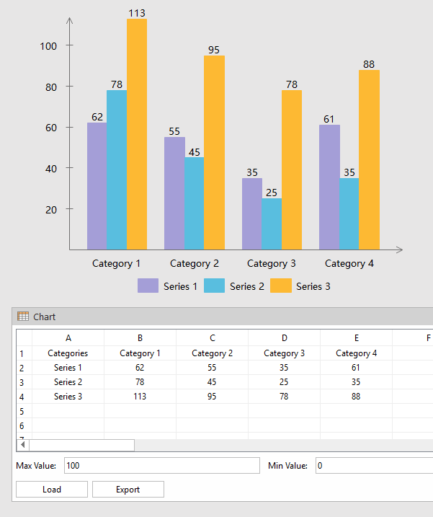
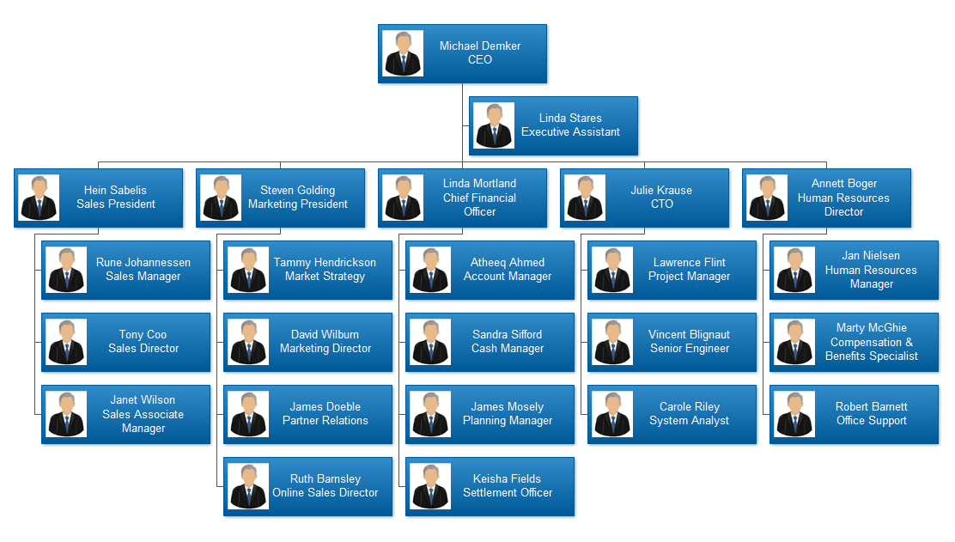
Data-interactive Charts
  Smart Wizard enables users to easily convert data into diagrams and vice versa.

Slide 12
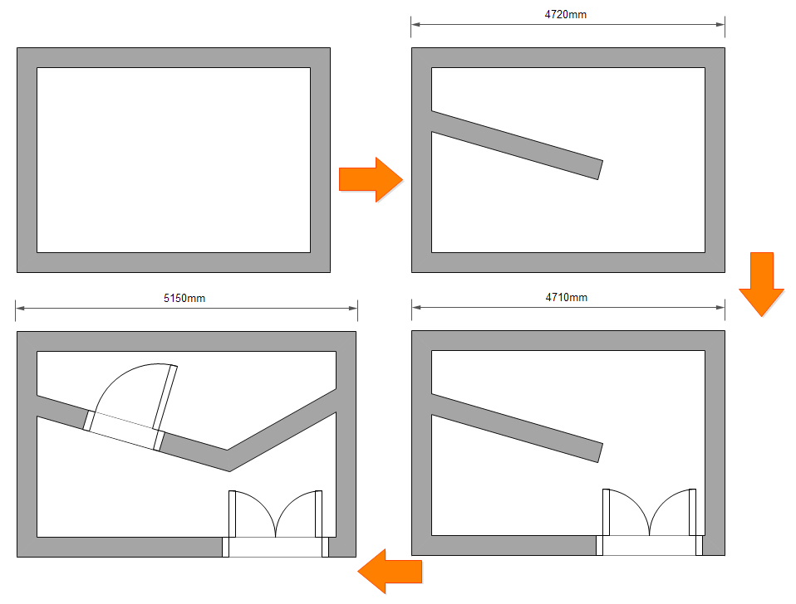
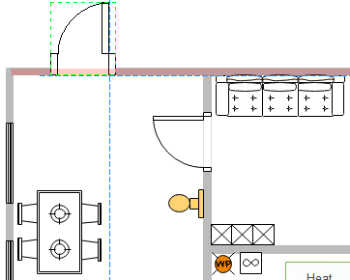
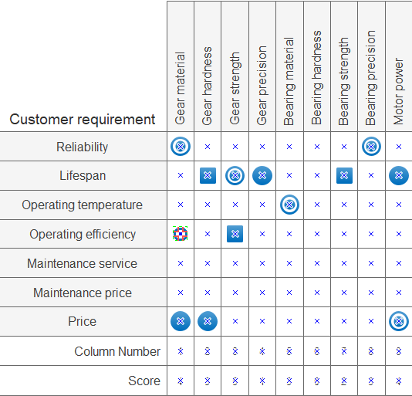
Automatically Snap and Glue
  The snap and glue function makes it easy to connect shapes and combine shapes together.

Slide 13
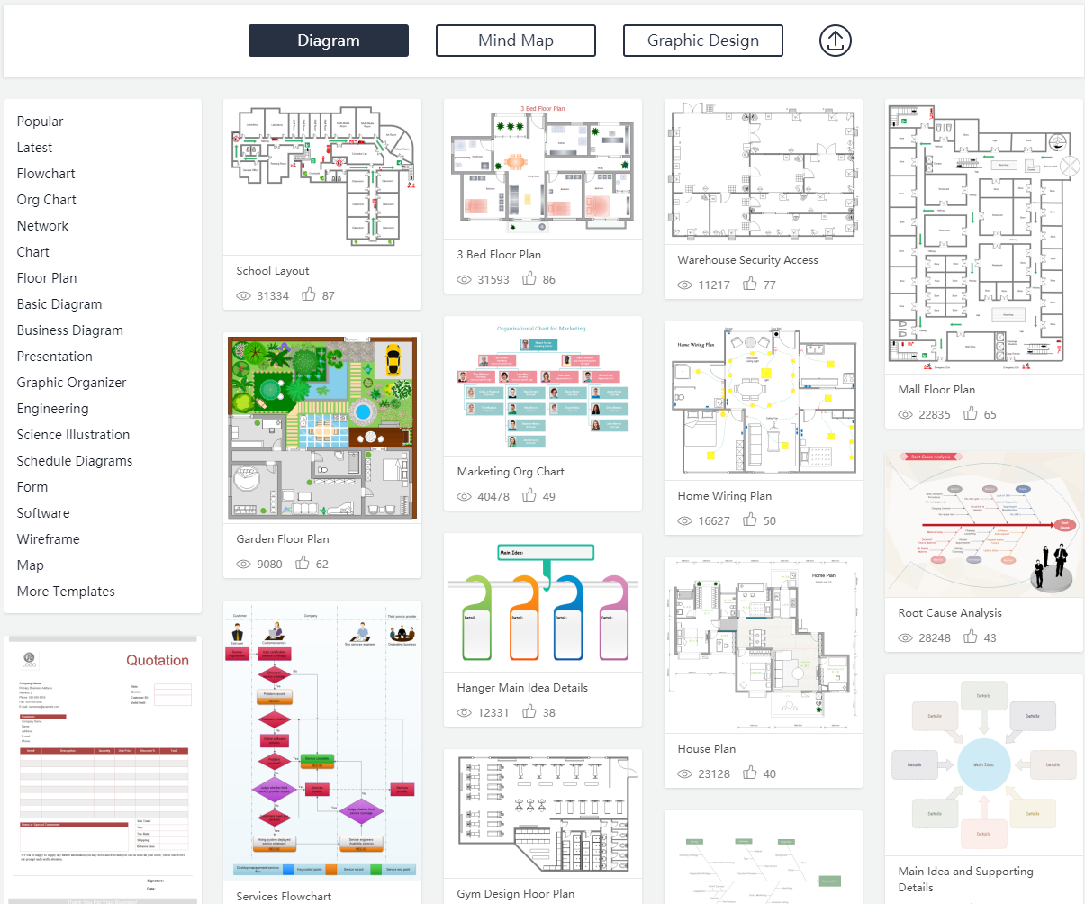

Free Online Templates Center
  You can search more templates from our Online Templates Center. You can also contribute templates so that other people could benefits from your contribution.

Slide 14
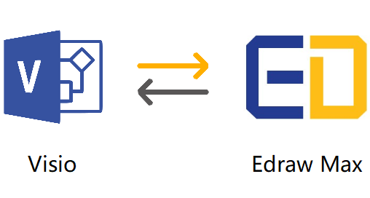
Edraw Max - A Solid Alternative to Microsoft Visio
Compatible with Visio .vsdx Files
Edraw Max has a pretty fine compatibility with Visio .vsdx files. Supports both import and export of Visio files.
Works on Windows, Mac and Linux
It's cross-platform based, and used as the best alternative for Visio users with Mac and Linux OS.
More Templates and Symbols than Visio
It has 12000+ symbols and 3000+ templates, and offers more drawing types including even infographics, charts, and graphic organizers.
Less Expensive and Better Service than Visio
It's much more affordable, and you can get a 24-hour email service.

Slide 15


Competitive Advantage of Edraw Max – Low Cost
Edraw Max is also quite advantageous in terms of license fee. You can spend a small amount of money yet receive more value.
With Edraw Max, you can choose an one-time fee instead of paying it for every year.

Slide 16
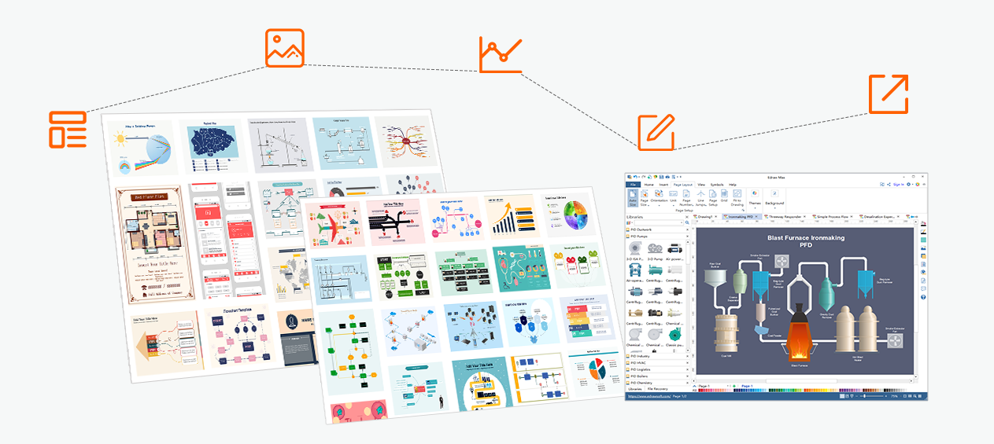
Thank You!
Edraw Max
All-in-one Diagram Design Software
http://www.edrawsoft.com
support@edrawsoft.com

